Slide 1

Process Diagram & Documentation Forms
Robert J. Esposito III, Christopher Dinis, Marc Castillo, & Rene Guevara
Professor Zesk
Configuration Management/ENGN 4010
March 26, 2018

Slide 2
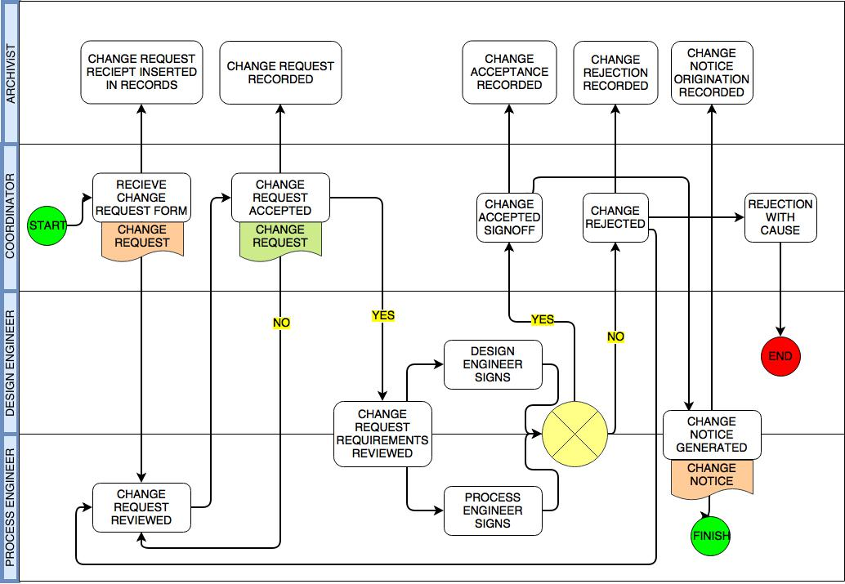
Process Diagram

Slide 3
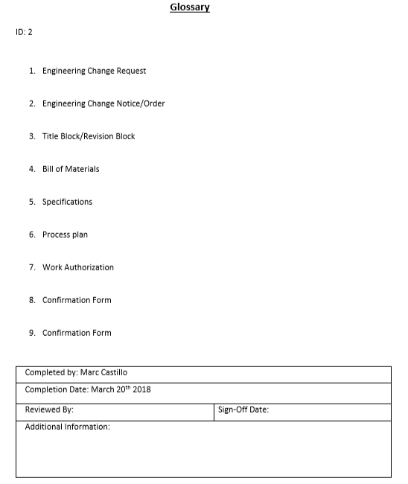
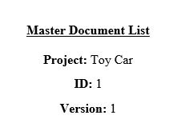

Slide 4
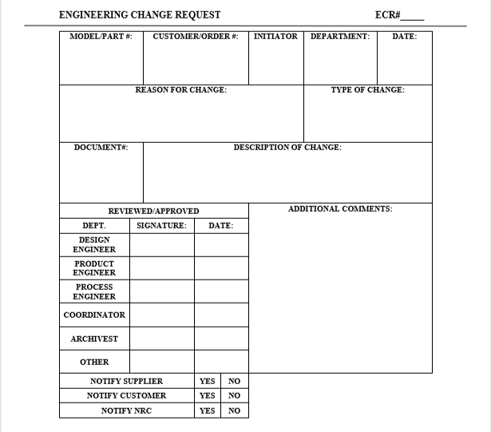
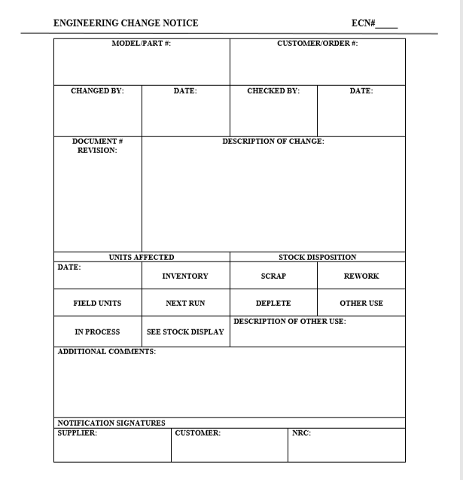

Slide 5
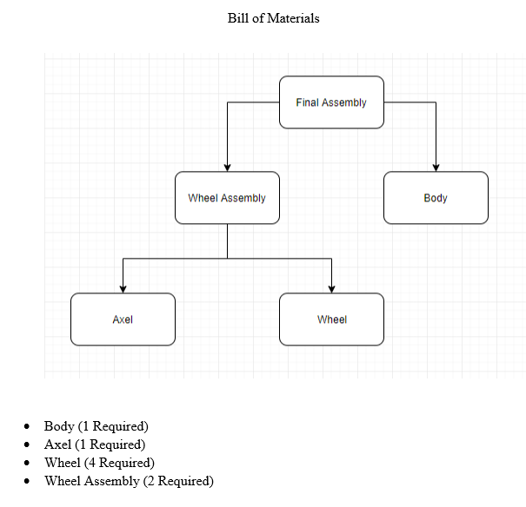

Slide 6
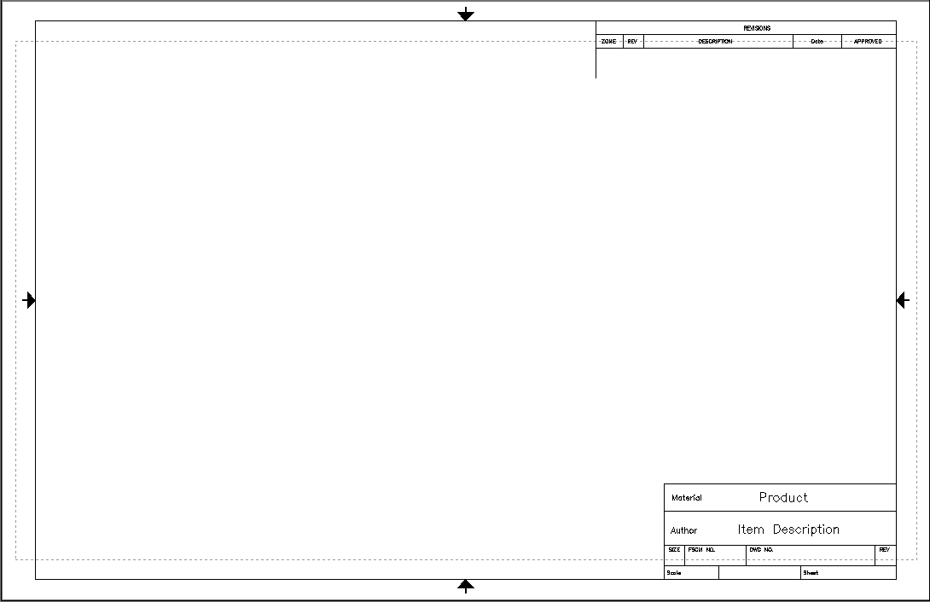

Slide 7
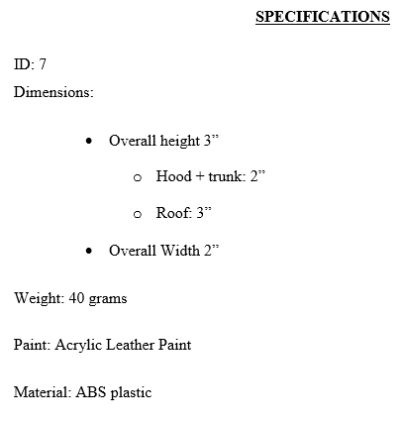
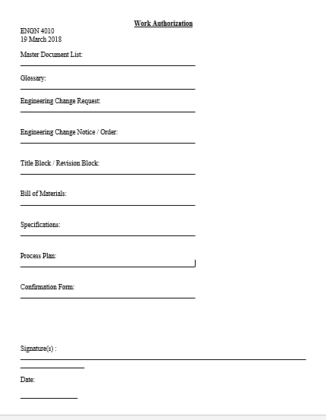

Slide 8
